Slide 1
Course Success Grants 2023 Creating Business-Savvy & Work-ready Accountants
NANDINI KRISHNA KUMAR
Director of Education
Accounting & Governance,
Macquarie Business School
(Lead Investigator)
with
Amy Tung
Rebecca Bachmann
Jessica Zhang
May 2023 updated in March 2024

Slide 2
THE CONTEXT

Slide 3
Our Focus at MQBS and What we were already doing well
MQBS School Learning Goals
Students will communicate and collaborate effectively.
Students will develop personal and professional agency. Students will be equipped for professional practice. Students will be equipped for working life beyond university.
Students will be proficient in technical, digital, quantitative and information-related skills relevant to their discipline.
Students will be able to apply critical thinking and analytical problem-solving skills.
Students will have business skills that incorporate an appreciation of global, ethical and environmental context and social responsibility.
Students will have knowledge of theory, models and concepts relevant to their discipline and be proficient in their synthesis and application.
QILT SES: Skills Development
Knowledge of study areas
Spoken communication Written communication
Teamwork
Complex Problem Solving
Critical thinking
Work readiness
LEU Feedback (on the MQBS learning goals) and the QILT SES surveys were telling us we were doing some things well…

Slide 4
Our Focus at MQBS and What we needed to do more of
MQBS School Learning Goals
Students will communicate and collaborate effectively.
Students will develop personal and professional agency. Students will be equipped for professional practice. Students will be equipped for working life beyond university.
Students will be proficient in technical, digital, quantitative and information-related skills relevant to their discipline.
Students will be able to apply critical thinking and analytical problem-solving skills.
Students will have business skills that incorporate an appreciation of global, ethical and environmental context and social responsibility.
Students will have knowledge of theory, models and concepts relevant to their discipline and be proficient in their synthesis and application.
QILT SES: Skills Development
Knowledge of study areas
Spoken communication Written communication
Teamwork
Complex Problem Solving
Critical thinking
Work readiness
…but there were other things which needed more attention

Slide 5
Professional demands: Professional Recruiters & CPA Australia
7 Skills for Accountants to Succeed on the Job
Robert Half ( Accounting executive search firm) report
Specialized experience (numeracy, accounting skills)
General business knowledge.
Up-to-date technology expertise.
Communication skills.( listening, speaking, writing)
Adaptability and flexibility.
Leadership abilities. (critical thinking, analytical ability, team work, decision making)
Customer service orientation.
https://www.roberthalf.com/blog/salaries-and-skills/the-accounting-job-skills-you-need-to-succeed
CPA Australia calls it “ Business Acumen” and says its in short supply!

Slide 6
What is Business Acumen?
How does CPA Australia define Business Acumen?
The Chartered Professional Accountants (CPA) of Australia defines Business acumen as covering the local and global organisational environment within which a business operates and also covers the features relating to business strategy and management. The basic principles of governance, risk management and internal controls adds a depth of understanding of business practices.
CPA Australia accreditation guidelines
Business acumen is also ‘someone's ability to understand and handle business situations. It is the collection of both general and organization-specific knowledge about how things get done and why. It is a key characteristic of leadership and shows up in the questions someone asks and the decisions they make.
www.betterup.com/blog/business-accumen

Slide 7
Professional accreditation requirement
CPA Australia includes Business Acumen in Professional Accreditation Guidelines !
CPA Australia accreditation guidelines

Slide 8
The Challenge of creating Business-savvy accountants
MOVE FROM MOSTLY CONTENT-FOCUS
We have been doing many things to help our students with the Content of what they learn i.e., subject knowledge, skills
TO INCLUDE MORE BUSINESS CONTEXT
The focus, next, is to help students appreciate the Context of where they will have to use this! i.e., Work-life in Industry, Services and Government

Slide 9
The Challenge of creating Business-savvy accountants
HOW CAN WE CREATE BUSINESS SAVVY STUDENTS ?
Raise Accounting Students appreciation of industry happenings and current business events
Help students understand the context in which their knowledge and skills will need to be applied
Increase Student engagement in class
Make students better listeners and more attentive and focused

Slide 10
The Challenge of creating Business-savvy accountants
MQBS Learning Goals
.. While keeping the alignment to the overarching MQBS learning goals
Accounting Course Success Plans
Unit Outcomes
L& T Projects, Activities and Strategies

Slide 11
THE PROJECT

Slide 12

Could Business Trivia be the answer ?
Literature (see References) points to Business Trivia Games as a potential solution!
Business and Accounting Trivia Question Bank !

Slide 13
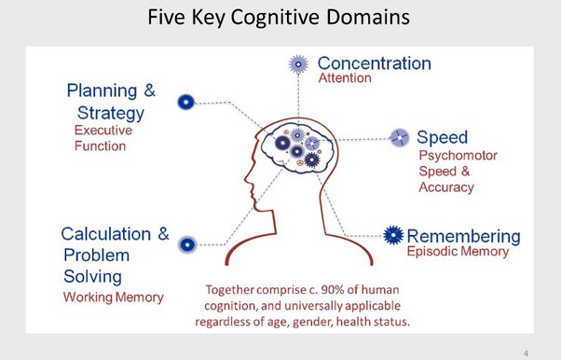
Why Business Trivia ?
Business Trivia is FUN !
Improved Cognitive Skills
Relieves boredom : better focus, attention and engagement for rest of the class
Better memory & response speed
Can relate subject matter to future business and work environment and adjust to work-life easily
Expands awareness, intelligence and creativity
Reduces dropouts improves retention
Big bang for the buck (takes only 5 min)
Image :https://thewrightinitiative.com/

Slide 14

How can we improve focus, sharpness and responsiveness?
Students are easily distracted by technology.
Regular, short breaks and fun activities can help them re-engage, focus, increase their productivity, and reduce their stress.
The nature of the activity can also add valuable general knowledge
Image: iStock

Slide 15
Project title : Improving Student Engagement and developing Business-Acumen Skills through Business Trivia games
Short 5-minute Business Trivia game
In the seminars/workshops across the units of:
Master of Accounting,
Master of Professional Accounting, and
Accounting and Auditing Specialisation of Master of Commerce
To promote:
student engagement and enthusiasm,
student retention and
employability-relevant business knowledge and skills
Pilot units chosen for S2 2023:
ACCG8121 Managerial Accounting, and
ACCG8125 Auditing and Assurance
Image: iStock

Slide 16
How the Project contributes to the 2023 strategic priority areas
ALIGNMENT :
2023 Macquarie Business School Learning Goals,
QILT Student Experience Survey findings, and
Master of Commerce Couse Success Plan and Value Proposition:
a) Students will develop a broad and keen awareness of the current business environment, especially related to finance, accounting, and the corporate business world.
b) Students will have business skills that incorporate an appreciation of global, ethical, and environmental context and social responsibility
c) Students will be able to think on their feet and exhibit improved response times.

Slide 17
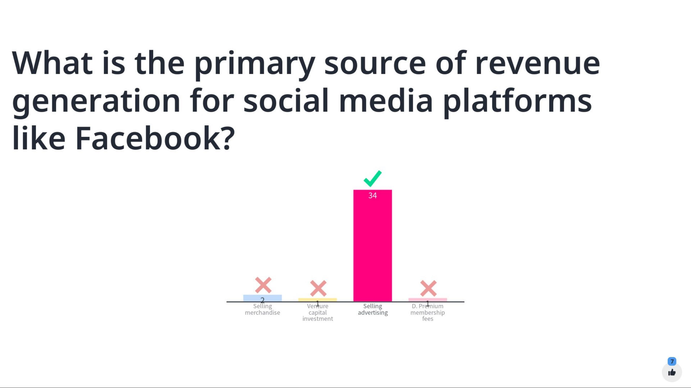
Sample Business Trivia Quiz questions

Slide 18
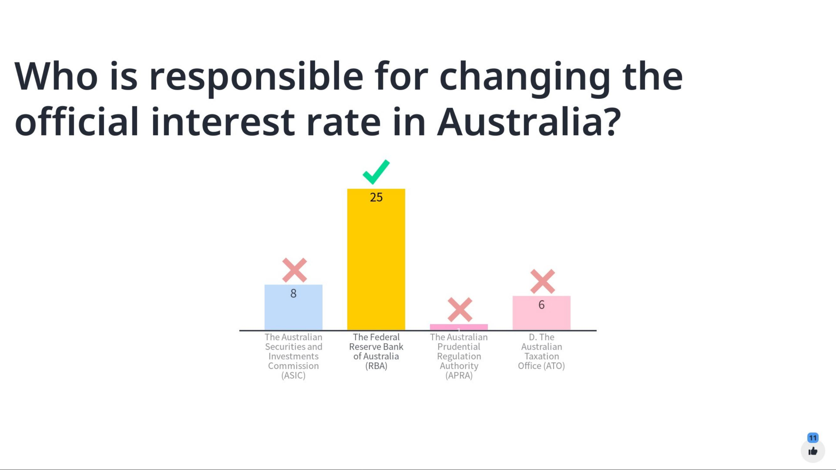
Sample Business Trivia Quiz questions

Slide 19
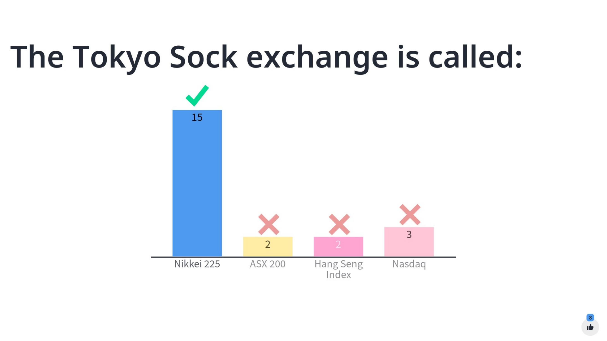
Sample Business Trivia Quiz questions
The Tokyo Stock Exchange is called:

Slide 20
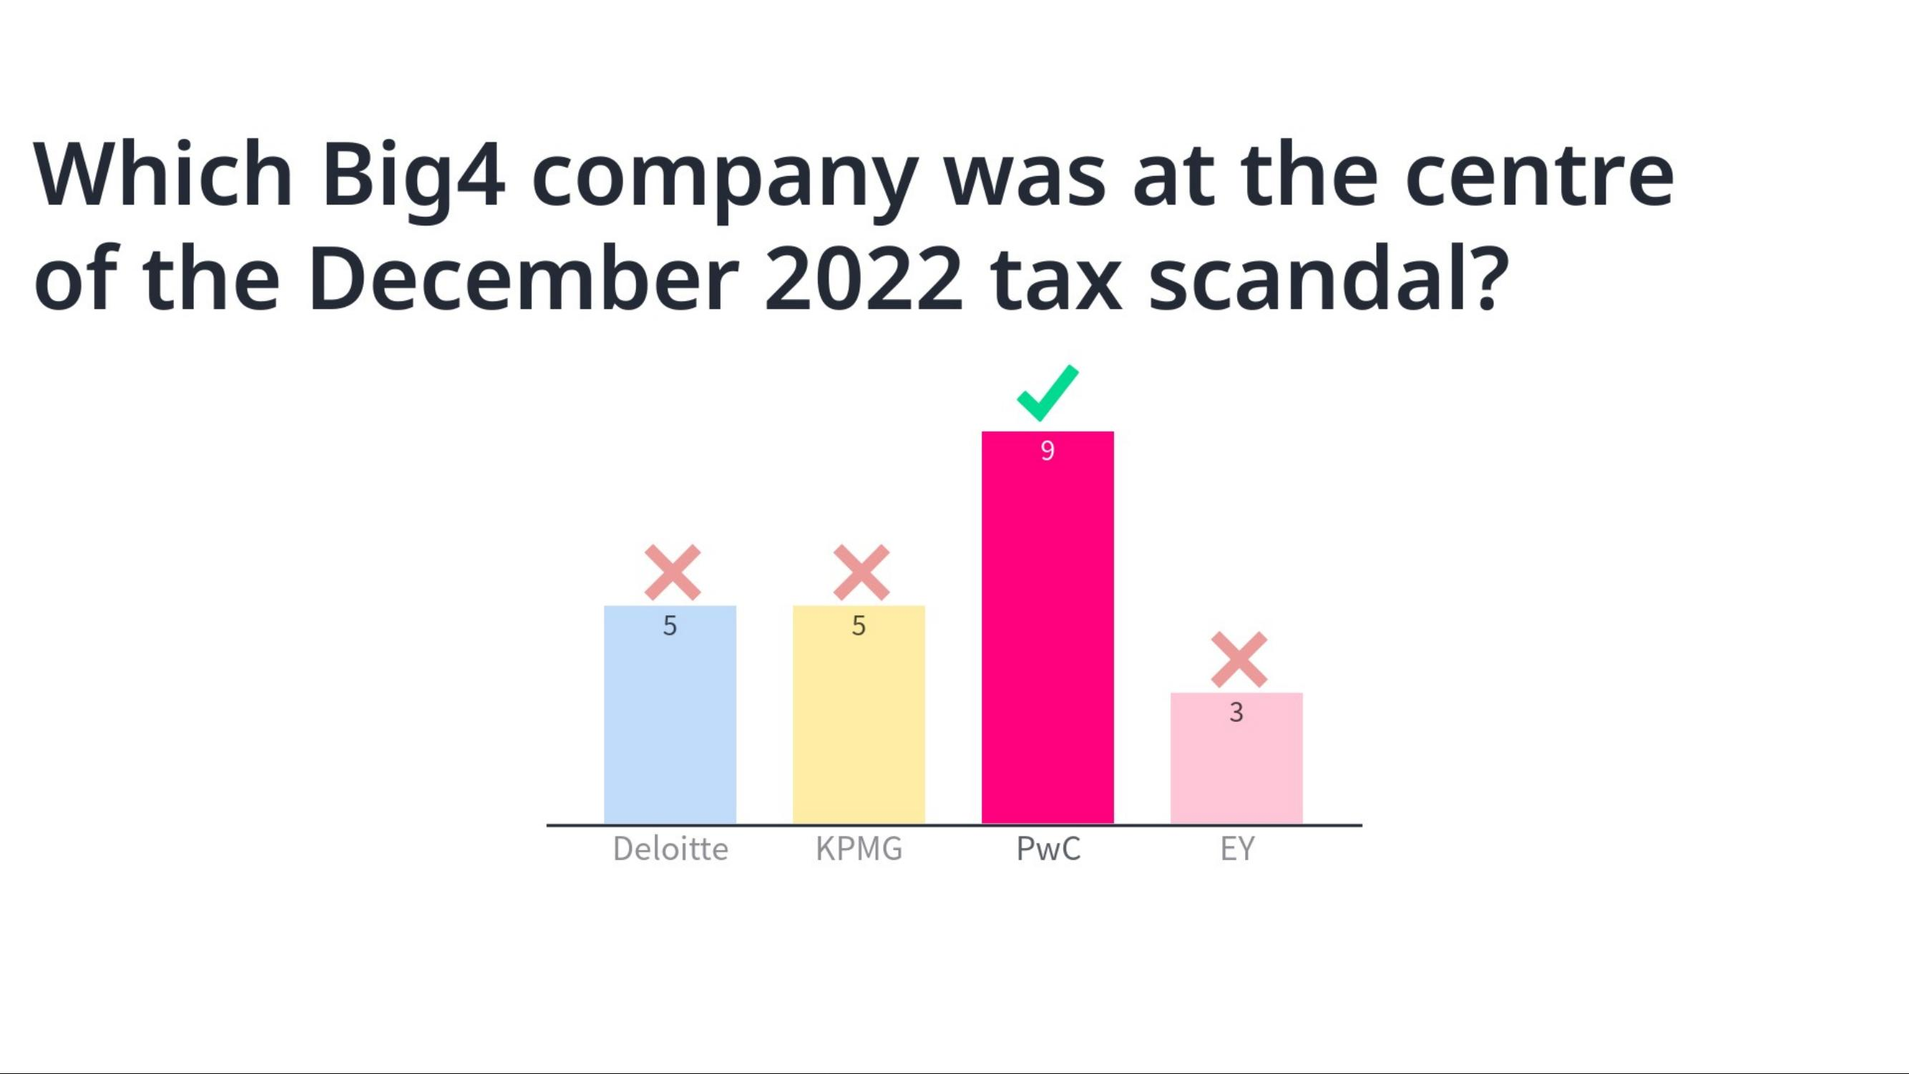

Slide 21
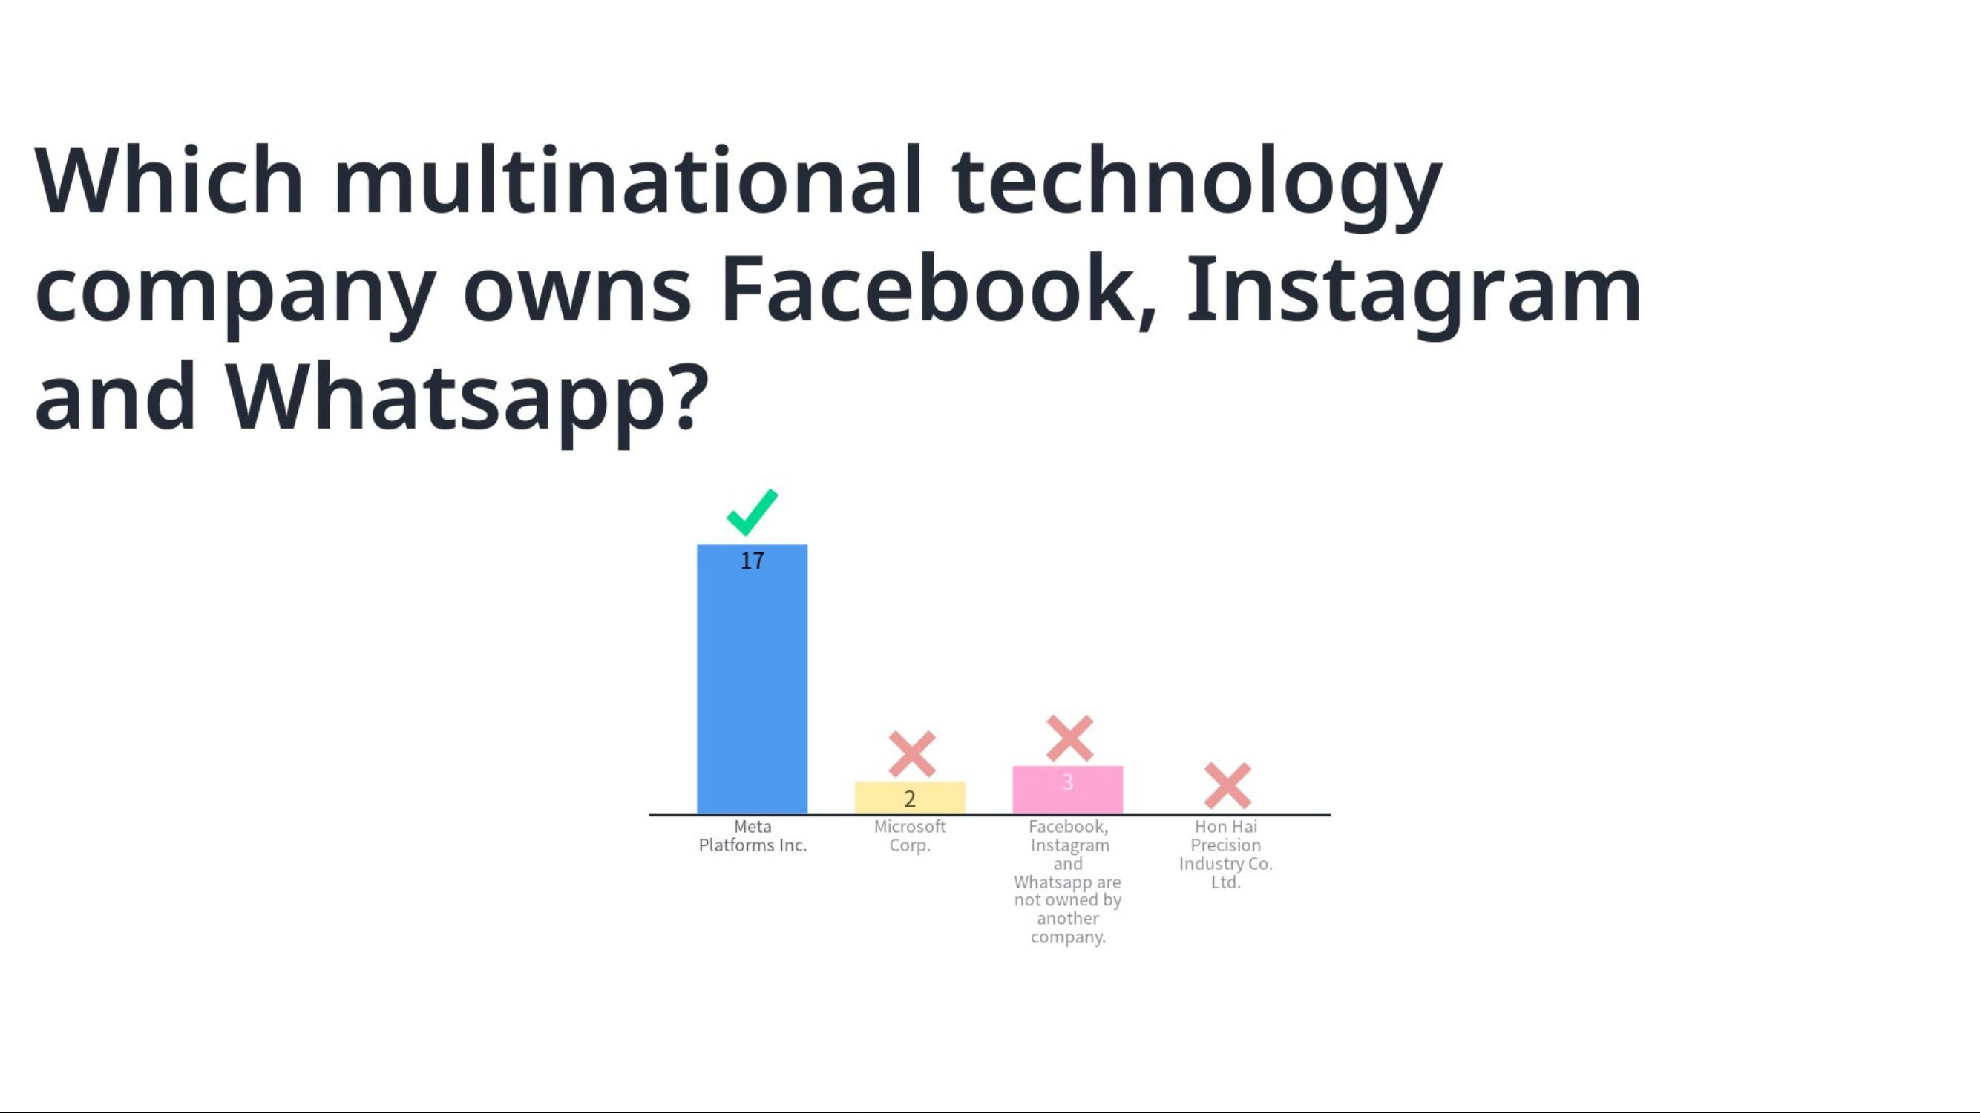

Slide 22
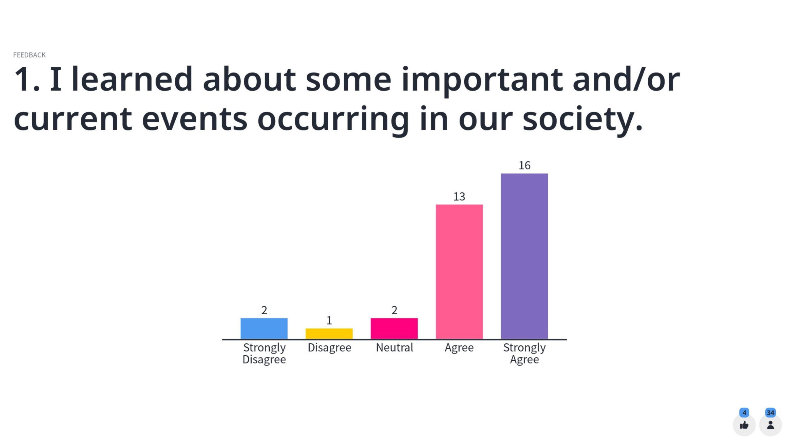
Instantaneous along-the-way survey within Mentimeter

Slide 23
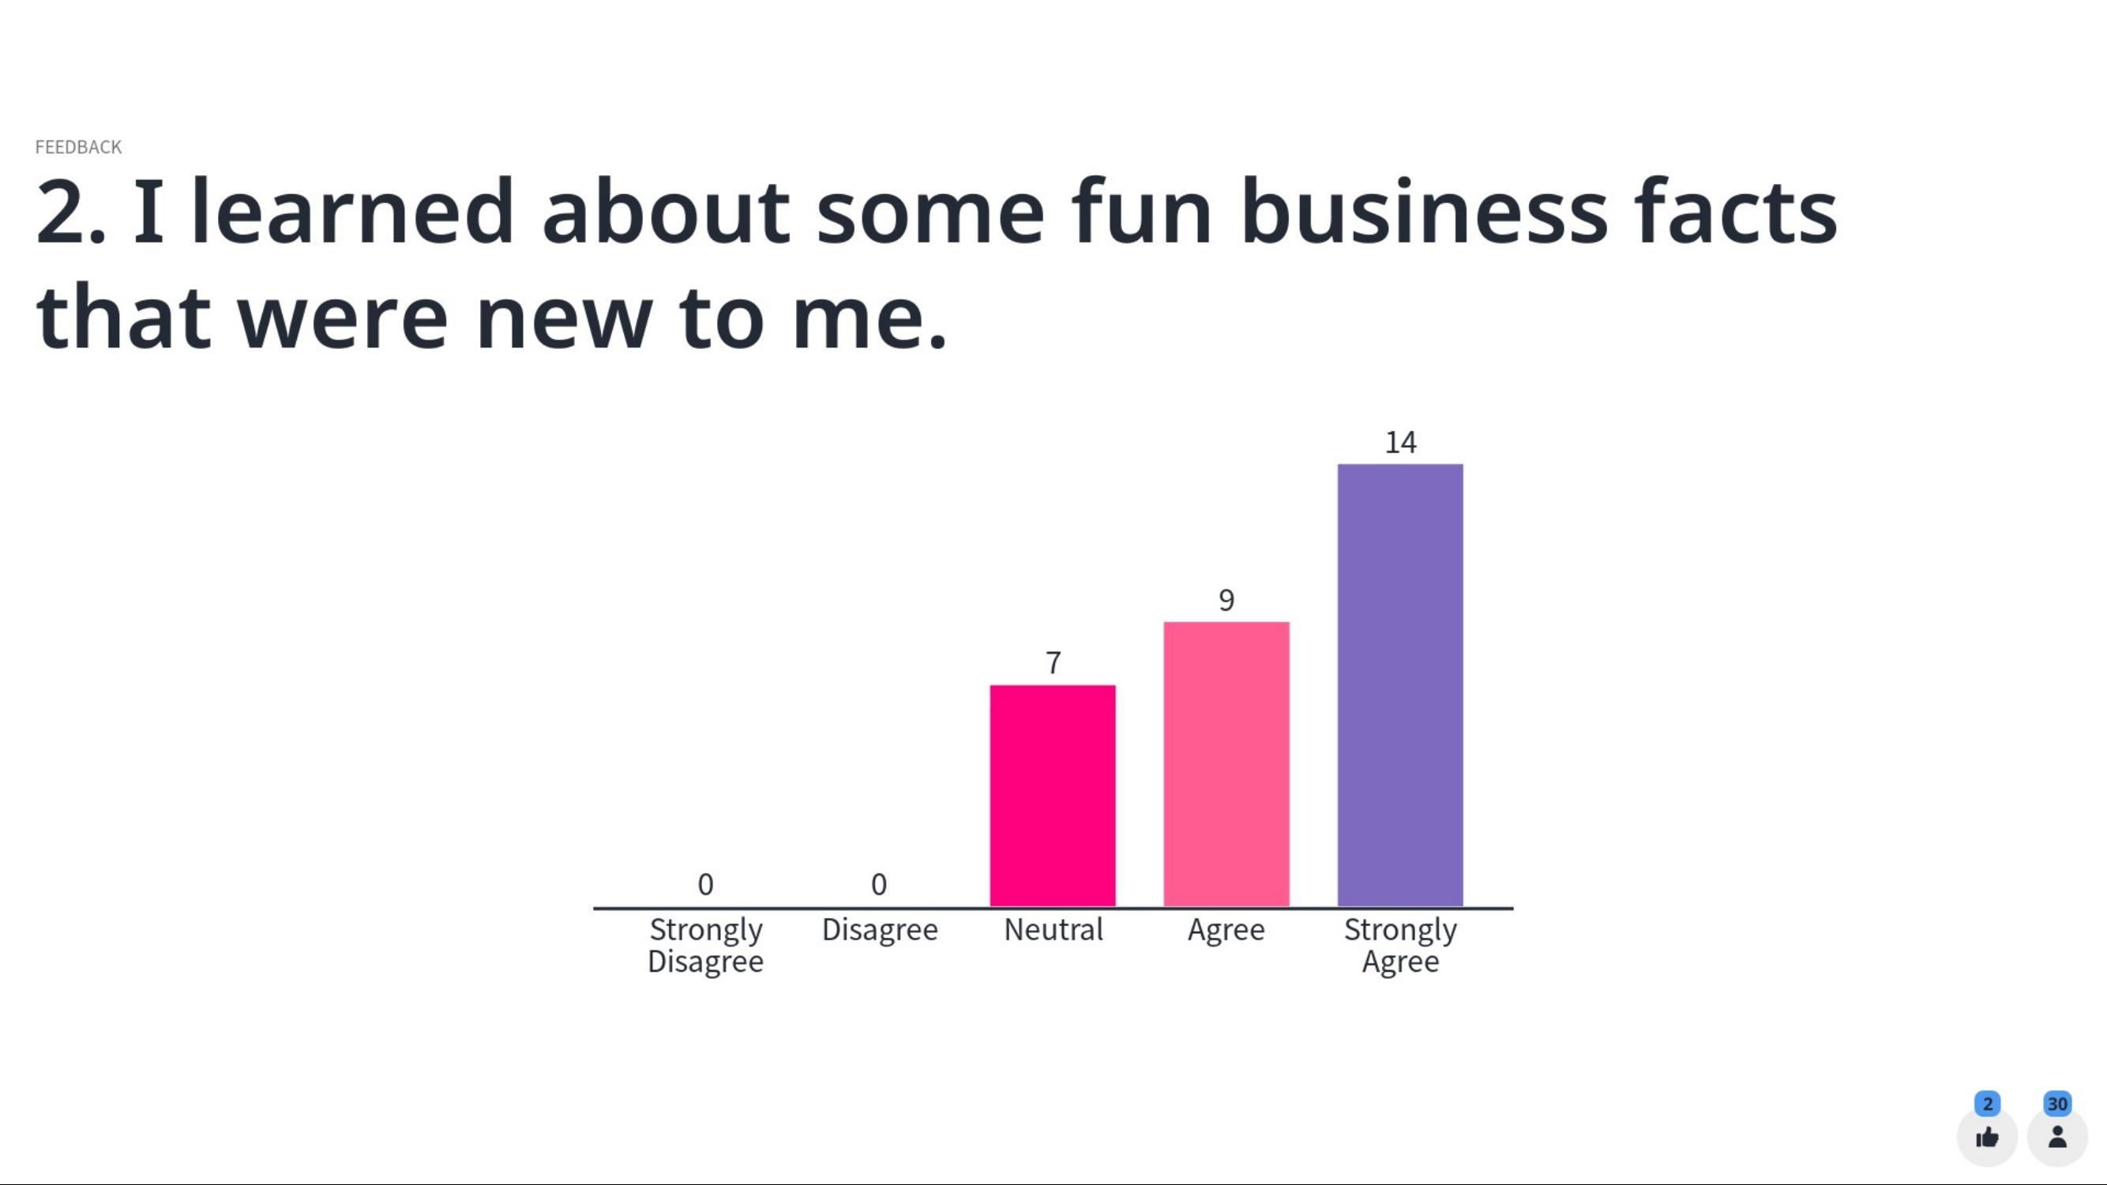
Instantaneous along-the-way survey within Mentimeter

Slide 24
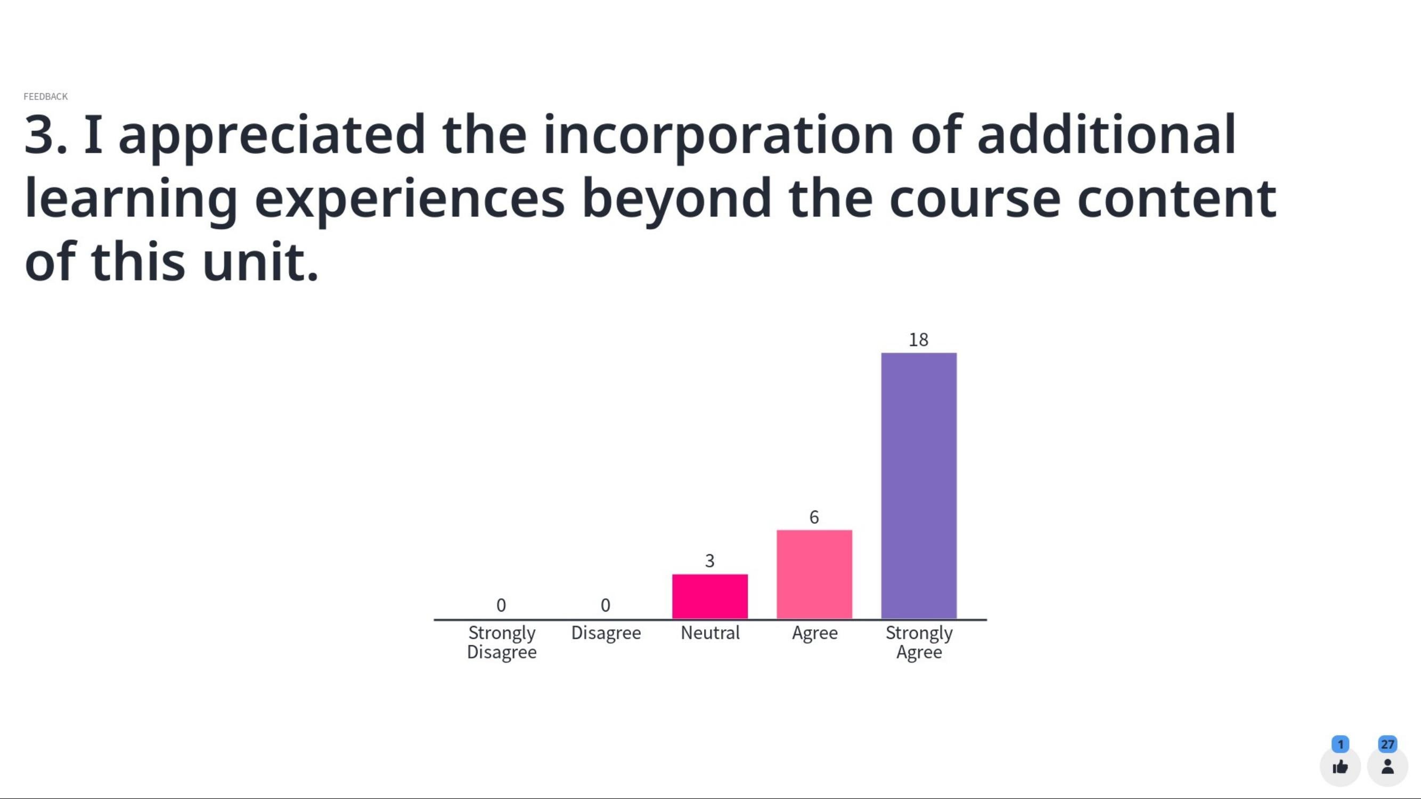
Instantaneous along-the-way survey within Mentimeter

Slide 25
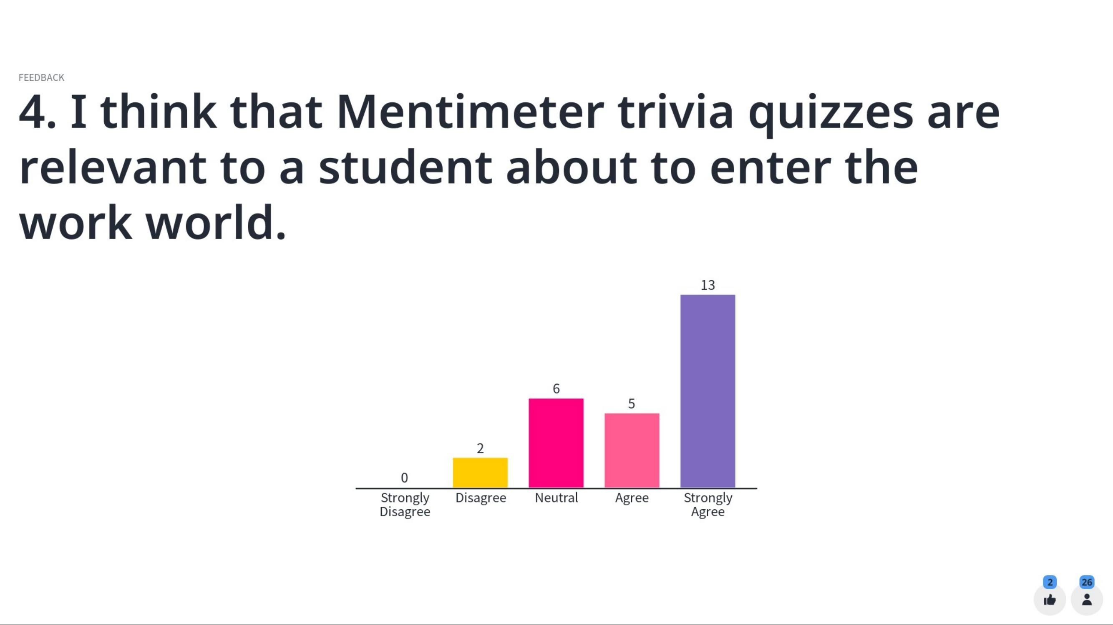
Instantaneous along-the-way survey within Mentimeter

Slide 26
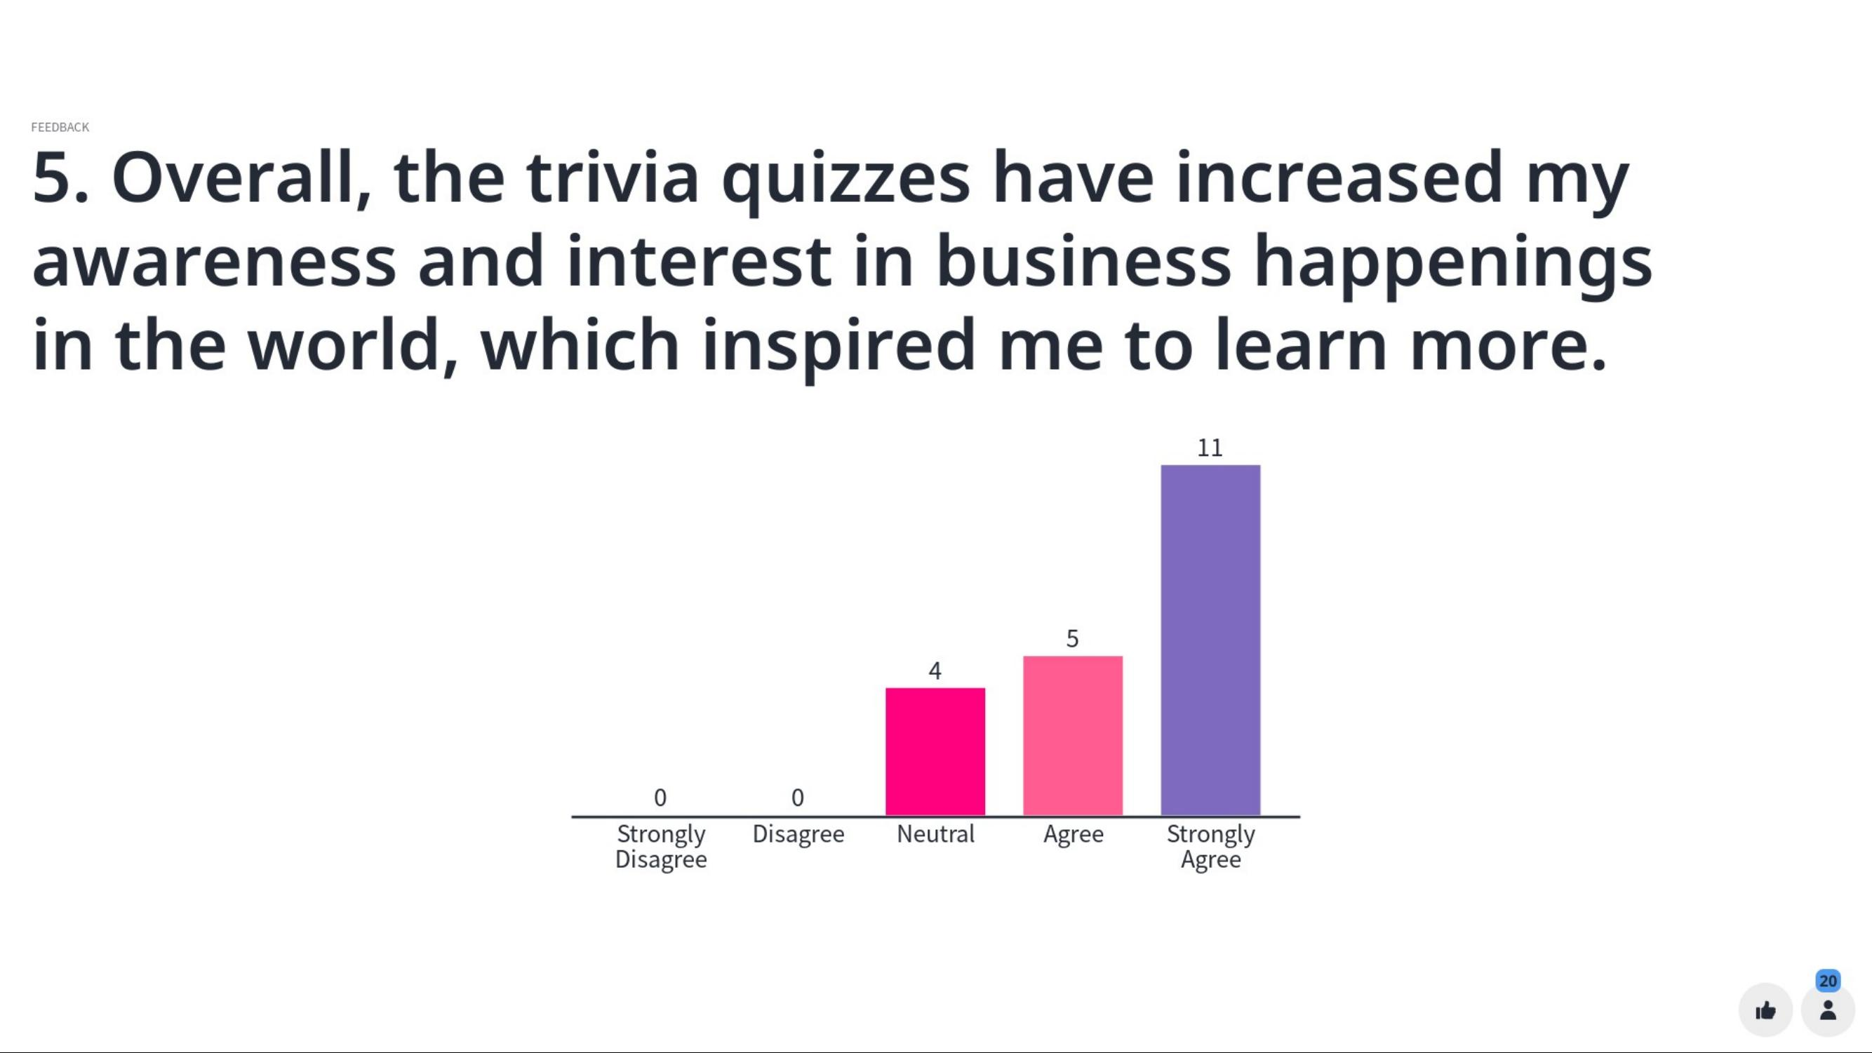
Instantaneous along-the-way survey within Mentimeter

Slide 27
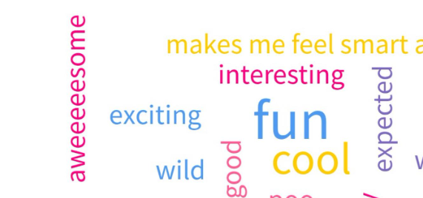

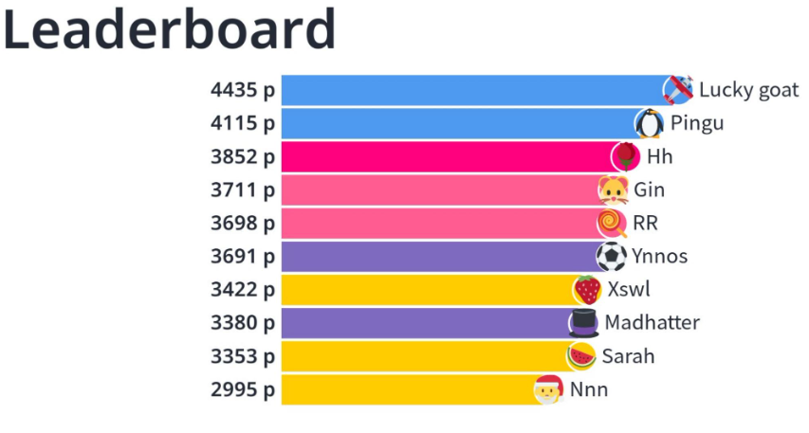
Instantaneous Mentimeter feedback capture & Leaderboard Screen dumps

Slide 28
THE OUTCOMES AND NEXT STEPS

Slide 29
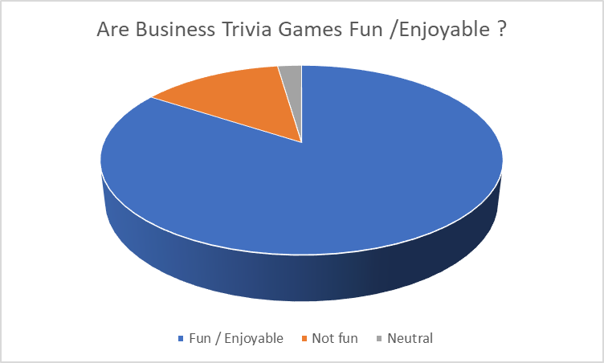
The Outcomes
Overall, 84.2 % of the students found Business Trivia games fun and enjoyable.

Slide 30
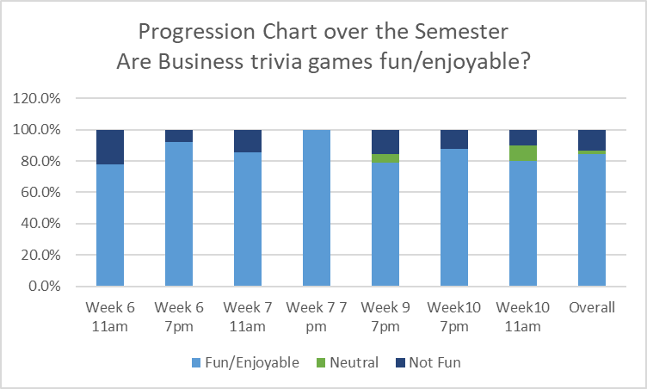
The Outcomes
The comfort level and enjoyment increased as the quiz difficulty level was adjusted and fine-tuned over the semester

Slide 31
The Outcomes

Slide 32
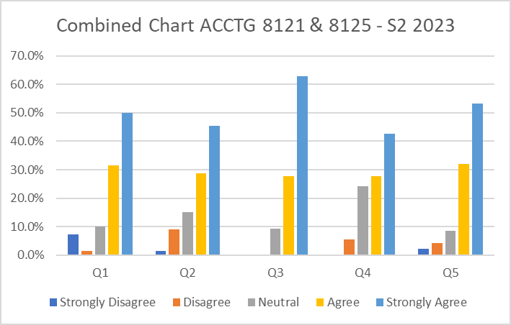
The Outcomes

Slide 33
The Conclusions & Next steps
Over longer term, Business Trivia games have the potential for cost-effective & excellent outcomes
Potential for using business trivia games as a productive learning interruption to revitalize classroom engagement and raise business acumen is immense.
The benefit to the community of accounting students and ability to make them more acceptable among their business peers is acknowledged.
This project establishes the business case, as well as identifies the key success factors, in the use of Business Trivia games to raise business acumen and improve student engagement.
Potential to expand extensively to the other units in the Master of Accounting, Master of Professional Accounting, and the Accounting and Auditing Specialisation of Master of Commerce, with the potential to even extend to the undergraduate accounting courses also, with minor changes in the content/difficulty level

Slide 34
References
Nouchi R, Taki Y, Takeuchi H, Hashizume H, Nozawa T, Kambara T, et al. (2013) Brain Training Game Boosts Executive Functions, Working Memory and Processing Speed in the Young Adults: A Randomized Controlled Trial. PLoS ONE 8(2): e55518. https://journals.plos.org/plosone/article?id=10.1371/journal.pone.0055518
https://www.roberthalf.com/us/en/insights/career-development/the-accounting-job-skills-you-need-to-succeed
Silva, R., Rodrigues, R. and Leal, C., 2021. Games based learning in accounting education–which dimensions are the most relevant?. Accounting Education, 30(2), pp.159-187.
Jackson, D. and Meek, S., 2021. Embedding work-integrated learning into accounting education: The state of play and pathways to future implementation. Accounting Education, 30(1), pp.63-85.
Lincoln Then James & Riza Casidy (2018) Authentic assessment in business education: its effects on student satisfaction and promoting behaviour, Studies in Higher Education, 43:3, 401-415.
Jewell, P., Reading, J., Clarke, M. and Kippist, L., 2020. Information skills for business acumen and employability: A competitive advantage for graduates in Western Sydney. Journal of Education for Business, 95(2), pp.88-105.
https://www.escape-london.co.uk/news/2018/6/28/the-benefits-of-brain-teasers-puzzles
Plump, C. M., & LaRosa, J. (2017). Using Kahoot! in the Classroom to Create Engagement and Active Learning: A Game-Based Technology Solution for eLearning Novices. Management Teaching Review, 2(2), 151–158 https://journals.sagepub.com/doi/10.1177/2379298116689783

Slide 35
THANK YOU

